Slide 1

National climate action plan and Intended Nationally Determined Contributions (INDCs); AI algorithms for predicting climate change; Data curation from climate sensors and simulations of global warming impacts
Information Security Fundamentals | Climate Change (Impacts, Adaptation and Mitigation)
Course: Information Security Fundamentals | Chapter: Climate Change (Impacts, Adaptation and Mitigation) | Bachelor of Engineering
DISCOVER · LEARN · EMPOWER
Notes:
Welcome to this lecture on climate action and data security. We will explore how national plans like INDCs drive policy and how AI algorithms predict global warming. Understanding data curation from sensors is crucial for accurate simulations of climate impacts.

Slide 2
Course Outcomes
SLIDE 2 / 14
Course Outcome
CO | BT LEVEL | DESCRIPTION
CO1 | BT4 | Recall, analyze and respond on fundamental environmental principles, such as ecological relationships and conservation strategies
CO2 | BT4 | Understand and analyze the interconnections between human activities and environmental impacts across different ecosystems
CO3 | BT4 | Understand and analyze and apply environmental laws and policies to analyse and propose solutions for real-world environmental challenges.
CO4 | BT2 | Students will analyse data from environmental monitoring programs to assess trends and predict future impacts on ecosystems.
CO5 | BT6 | Interpret, elaborate and propose various tools, design and innovative strategies for sustainable development and environmental conservation initiatives in securing the planet.
Chandigarh University
2 / 14
Notes:
This lecture directly addresses Course Outcome 3. You will learn to analyze environmental policies like the National Action Plan and apply them to real-world challenges. We will also examine how data curation supports these policy decisions through AI simulations.

Slide 3
Learning Objectives
SLIDE 3 / 14
Learning Outcomes
1
Analyze the structure and goals of India's National Climate Action Plan.
2
Evaluate the role of INDCs in global climate mitigation strategies.
3
Examine how AI algorithms predict climate change patterns using sensor data.
4
Assess the importance of data curation for accurate global warming simulations.
5
Propose solutions for integrating AI and policy in environmental security.
Chandigarh University
3 / 14
Notes:
By the end of this session, you will be able to analyze national plans and evaluate INDCs. We will examine how AI algorithms process sensor data to predict climate shifts. Finally, you will assess data curation methods to propose better environmental solutions.

Slide 4
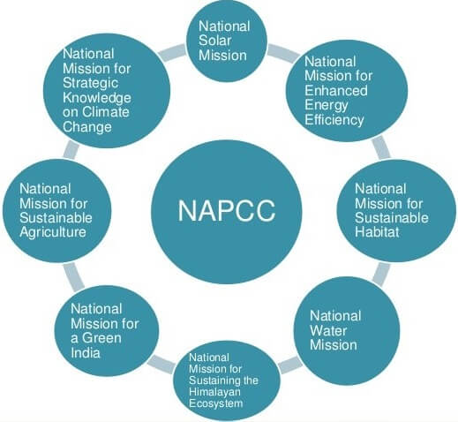
Lecture
SLIDE 4 / 14
National Climate Action Plan Overview
1
The National Action Plan on Climate Change (NAPCC) outlines eight national missions.
2
Each mission targets specific sectors like solar energy, water, and sustainable agriculture.
3
The plan integrates economic growth with environmental sustainability and climate resilience.
4
It establishes a framework for monitoring progress through specific performance indicators.
5
Implementation requires coordination between central ministries and state-level authorities.
6
The plan emphasizes technology transfer and capacity building for local communities.
7
NAPCC serves as the foundational policy document for India's climate strategy.
India's National Action Plan On Climate Change (NAPCC) - PMF IAS
Chandigarh University
4 / 14
Notes:
The NAPCC is India's roadmap for climate action, comprising eight distinct missions. For instance, the Solar Mission aims to generate 100 GW of solar power by 2022. This plan ensures that economic development does not come at the cost of environmental degradation.

Slide 5
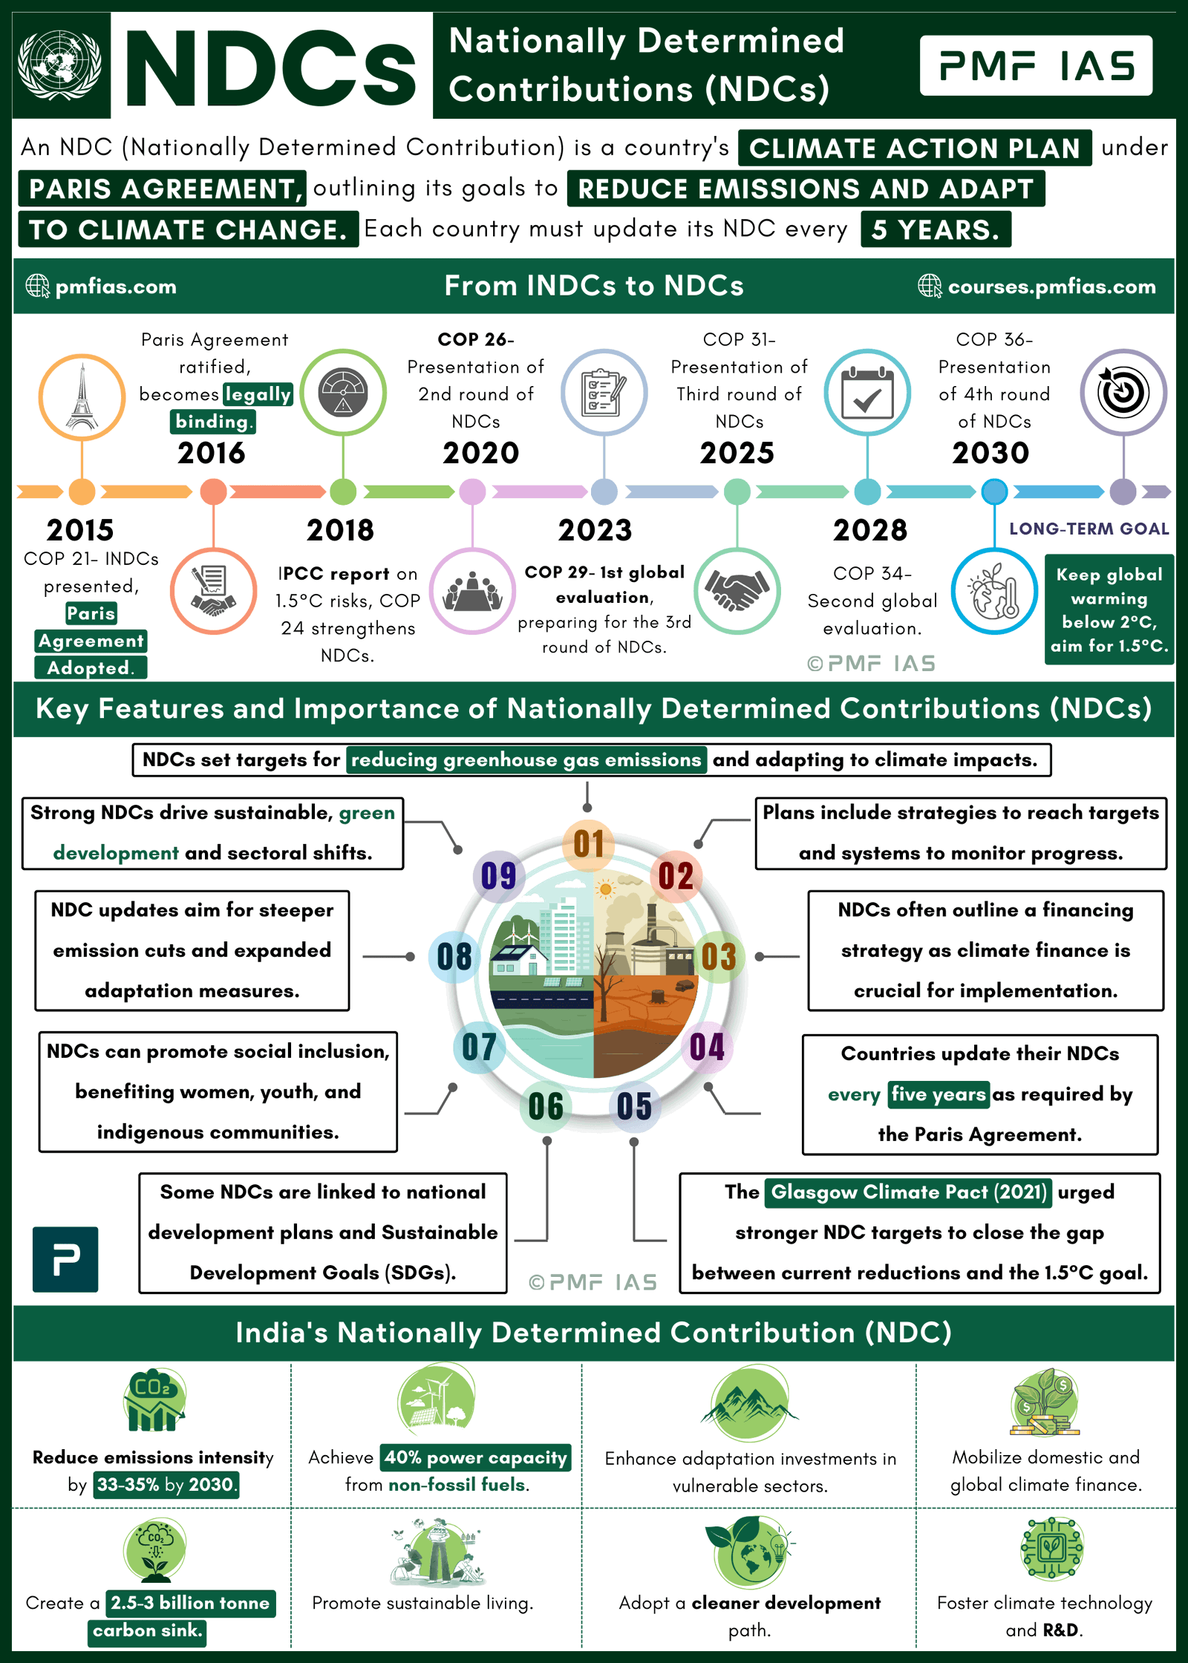
Lecture
SLIDE 5 / 14
Intended Nationally Determined Contributions (INDCs)
1
INDCs are voluntary climate action plans submitted by countries under the Paris Agreement.
2
India's INDC targets a 33-35% reduction in emissions intensity by 2030.
3
The goal includes achieving 40% of electricity generation from non-fossil sources.
4
INDCs create a transparent framework for international accountability and cooperation.
5
They require regular updates to reflect technological advancements and policy shifts.
6
The submission process involves detailed national inventories of greenhouse gas emissions.
7
INDCs bridge the gap between national policies and global climate goals.
Nationally Determined Contributions (NDCs) (source: pmfias.b-cdn.net)
Chandigarh University
5 / 14
Notes:
INDCs are the core of the Paris Agreement, where nations pledge their specific targets. India committed to reducing emissions intensity by 33-35% by 2030 compared to 2005 levels. This pledge drives our national policies and international reporting mechanisms.

Slide 6
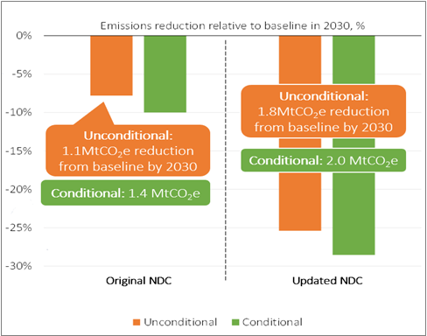
Lecture
SLIDE 6 / 14
AI Algorithms for Climate Prediction
1
Machine learning models analyze historical weather data to predict future trends.
2
Neural networks detect complex non-linear patterns in temperature and precipitation.
3
AI algorithms process satellite imagery to monitor deforestation and ice melt rates.
4
Deep learning models improve accuracy by learning from simulation errors over time.
5
Real-time data streams allow for dynamic updates to climate risk assessments.
6
AI reduces computational time required for complex global circulation models.
7
These algorithms enable early warning systems for extreme weather events.
Nationally Determined Contributions (Is There Global Climate Ambition?) (source: emission-index.b-cdn.net)
Chandigarh University
6 / 14
Notes:
AI algorithms are revolutionizing climate prediction by finding patterns humans miss. For example, a neural network can analyze 50 years of temperature data to predict a heatwave with 90% accuracy. This capability is vital for preparing infrastructure and saving lives.

Slide 7
Lecture
SLIDE 7 / 14
Data Curation from Climate Sensors
1
Data curation involves cleaning, organizing, and validating raw sensor measurements.
2
Climate sensors collect temperature, humidity, and CO2 levels from diverse locations.
3
Curation removes noise and outliers caused by sensor malfunctions or calibration drift.
4
Standardized formats ensure compatibility between different sensor networks globally.
5
Metadata tagging provides context for the time, location, and sensor type.
6
Secure data pipelines prevent unauthorized access to critical climate information.
7
High-quality curated data is the foundation for reliable AI predictions.
Nationally Determined Contributions (Is There Global Climate Ambition?) (source: emission-index.b-cdn.net)
Chandigarh University
7 / 14
Notes:
Raw data from sensors is often noisy and unreliable without curation. Imagine a sensor drifting by 2 degrees; without curation, this error propagates through the model. We clean this data to ensure the AI learns from accurate signals, not noise.

Slide 8
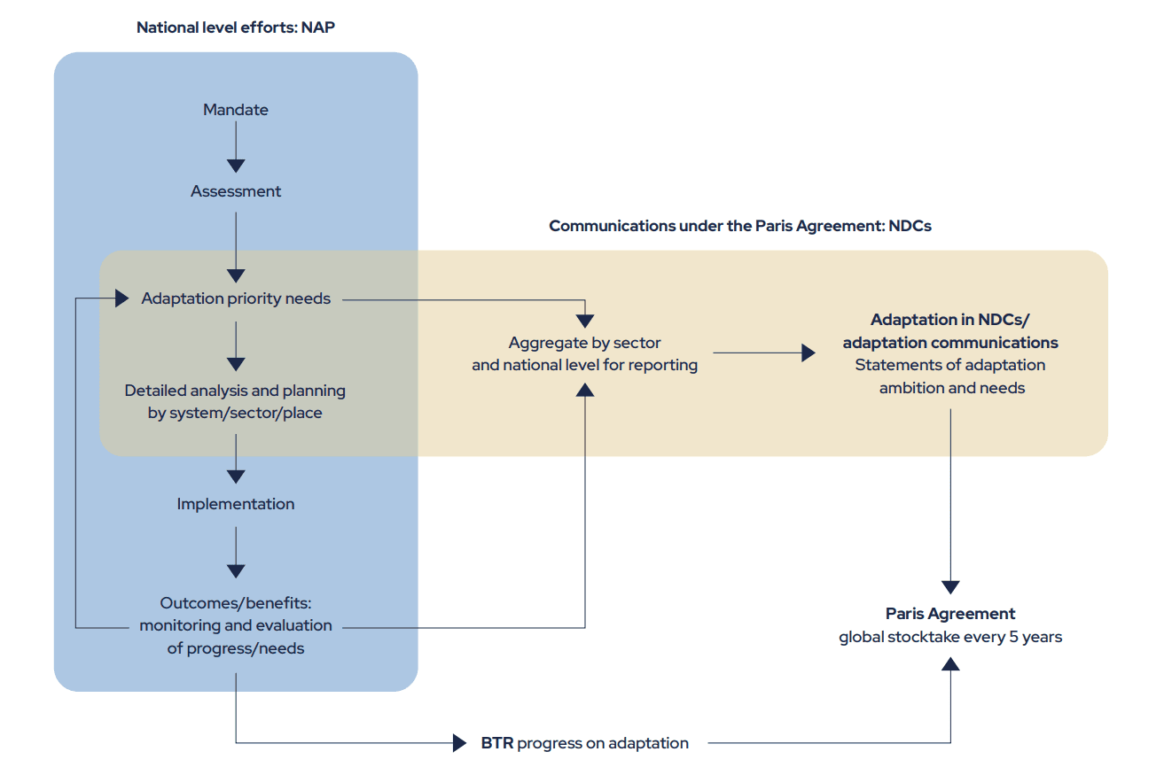
Lecture
SLIDE 8 / 14
Simulations of Global Warming Impacts
1
Simulations model the interaction between atmosphere, oceans, and land surfaces.
2
They project sea-level rise based on ice sheet melting rates.
3
Models predict shifts in agricultural zones due to changing rainfall patterns.
4
Simulations assess the economic impact of extreme weather events on infrastructure.
5
They help policymakers test the effectiveness of different mitigation strategies.
6
Uncertainty quantification is essential for interpreting simulation results accurately.
7
These tools provide a virtual laboratory for testing climate interventions.
NAP & NDC - Adaptation Community (source: www.adaptationcommunity.net)
Chandigarh University
8 / 14
Notes:
Simulations act as a virtual laboratory for testing climate interventions. For instance, we can simulate a 2-degree rise to see how Mumbai's coastline might change. These models help us understand the physical consequences of our current emissions trajectory.

Slide 9
Worked Numerical Example
SLIDE 9 / 14
Emissions Intensity
GOVERNING EQUATION
Emissions Intensity = Total CO2 Emissions / GDP (in constant prices)
TARGET
Reduce intensity by 35% relative to 2005 baseline.
CALCULATION
Target Intensity = 2.0 × (1 - 0.35) = 1.3 Mt/unit.
• Base Year (2005): Emissions = 2000 Mt, GDP = 1000 units.
• Target Year (2030): GDP increases by 50% to 1500 units.
• Required Emissions = 1.3 × 1500 = 1950 Mt.
• This shows a 50 Mt reduction is needed despite economic growth.
NAP & NDC - Adaptation Community (source: www.adaptationcommunity.net)
Chandigarh University
9 / 14
Notes:
Let's calculate the emissions target. If GDP grows by 50%, we must reduce total emissions to maintain the 35% intensity cut. The math shows we need to lower emissions from 2000 Mt to 1950 Mt. This demonstrates the challenge of decoupling growth from emissions.

Slide 10
Lecture
SLIDE 10 / 14
Common Pitfalls in Climate Data Analysis
1
Ignoring sensor calibration drift leads to systematic errors in long-term trends.
2
Overfitting AI models to historical data reduces predictive power for future events.
3
Failing to account for urban heat islands skews temperature analysis.
4
Using incomplete datasets creates biased simulations of global warming impacts.
5
Neglecting data security risks can lead to manipulation of climate records.
6
Assuming linear trends ignores the non-linear nature of climate systems.
7
Lack of standardization prevents merging data from different global networks.
Nationally Determined Contributions (Is There Global Climate Ambition?) (source: emission-index.b-cdn.net)
Chandigarh University
10 / 14
Notes:
A common pitfall is ignoring sensor drift, which can make a stable climate look like it's warming. Another is overfitting AI models, where they memorize past data but fail to predict new extreme events. Always validate your data sources and model assumptions.

Slide 11
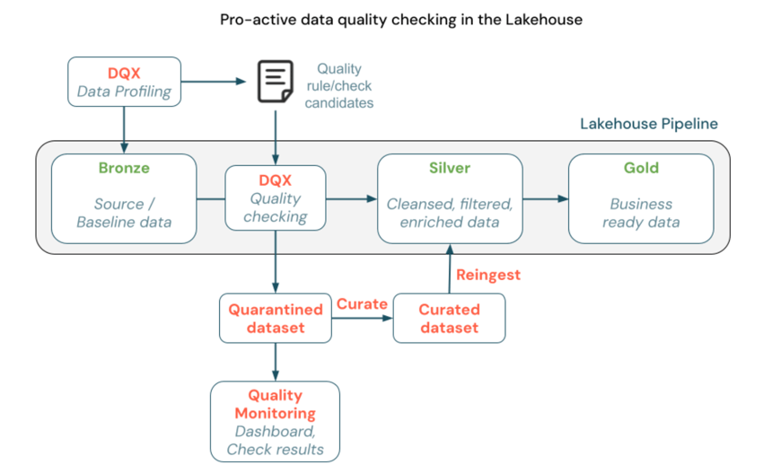
Lecture
SLIDE 11 / 14
Why Data Curation Matters for Policy
1
Accurate data curation ensures that policy decisions are based on facts.
2
Clean data allows for precise tracking of INDC progress and targets.
3
It enables early detection of deviations from national climate action plans.
4
High-quality data builds trust among international partners and stakeholders.
5
Curation supports the development of robust AI models for future planning.
6
It helps identify specific regions needing urgent adaptation interventions.
7
Without curation, policy responses may be misdirected or ineffective.
Source: www.advancinganalytics.co.uk
Chandigarh University
11 / 14
Notes:
Data curation is the backbone of effective policy. If our data is dirty, we might build sea walls in the wrong places. Clean data ensures that our National Action Plan targets the right areas and that our INDCs are met with confidence.

Slide 12
Lecture
SLIDE 12 / 14
Integration of AI and Policy Frameworks
1
AI tools provide real-time feedback loops for policy adjustment.
2
They help simulate the impact of new regulations before implementation.
3
Integration requires secure data sharing between government and research bodies.
4
AI can optimize resource allocation for climate adaptation projects.
5
Policy frameworks must evolve to include algorithmic decision support systems.
6
Ethical considerations guide the use of AI in sensitive environmental contexts.
7
Collaboration ensures technology serves national and global climate goals.
Chandigarh University
12 / 14
Notes:
The future lies in integrating AI directly into policy frameworks. Imagine a system that automatically adjusts water distribution based on AI-predicted droughts. This integration makes our National Action Plan dynamic and responsive to real-time changes.

Slide 13
Lecture
SLIDE 13 / 14
Key Takeaways
1
NAPCC and INDCs provide the strategic framework for India's climate action.
2
AI algorithms are essential for accurate prediction of climate change impacts.
3
Data curation ensures the reliability of sensor inputs for simulations.
4
Numerical analysis shows the trade-offs between economic growth and emissions.
5
Addressing data pitfalls is critical for effective environmental security.
Chandigarh University
13 / 14
Notes:
To summarize, we have seen how NAPCC and INDCs guide our strategy. AI and data curation are the tools that make these strategies actionable and accurate. Remember, the quality of your data determines the quality of your policy solutions.

Slide 14
Lecture
SLIDE 14 / 14
References
ENVIRONMENTAL STUDIES
From Crisis to Cure — R. Rajagopalan
• Environmental Science and Engineering — Benny Joseph
• Environmental Studies — R.C. Sharma and D. Gurbir Sangha
• Introduction to Environmental Science — Anjaneyulu, Y.
• Environmental Pollution Control Engineering — C.S. Rao
• Textbook of Environmental Studies for undergraduate courses — E. Bharucha
• Environmental Science — S.C. Santra
Chandigarh University
14 / 14
Notes:
These textbooks provide the foundational knowledge for the topics discussed today. Please refer to Benny Joseph for engineering aspects and R.C. Sharma for policy details. These resources will support your understanding of environmental laws and AI applications.

